Slide 1
Unit Testing - solid fundamentals
Milan Vukoje
www.Vukoje.NET
vukoje@gmail.com

Slide 2
Themes
Why testing?
Where to start?
Basics & Examples
What (not) to test?
TDD
Test Doubles

Slide 3
Why testing?
Coding is hard
Stabilization phases
Manual tests
Complexity
Missing specs
Is it working?
We hate software ☺
Average cost of defects
Construction | 1
System test | x10
Post release | x10-25

Slide 4

The goal!
Change fast
Fail fast
Executable specification
Redefining “Done”
Trust
Automatization

Slide 5

What is UT?
Code that verifies unit behavior
A unit is the smallest testable part of an application.
Written and run by software developers
Unit vs. Integration tests

Slide 6


Where to start?
Start small and enhance
Mind shifting
Test Driven Development: By Example – Kent Beck
xUnit Test Patterns: Refactoring Test Code - Gerard Meszaros

Slide 7
Example [1] - Calculator

Slide 8
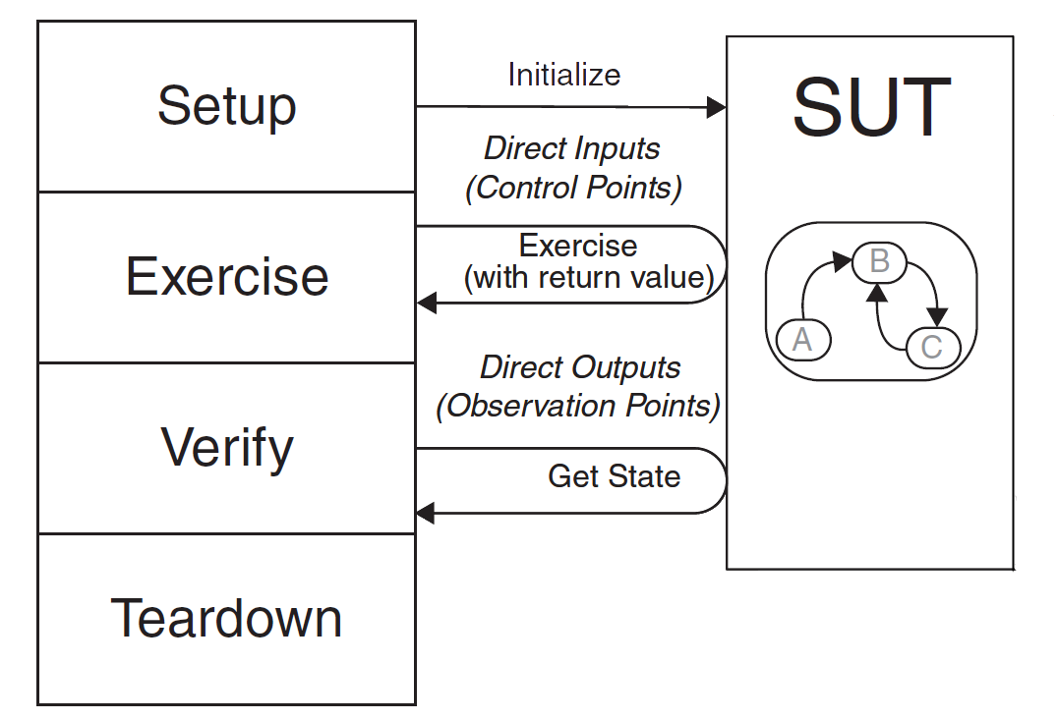
Unit Testing phases

Slide 9
Example [2] - Counter

Slide 10
What to unit test?
Calculations
State (initialization and transitions)
Conditionals
Loops
Polymorphism & Operators
Persistency
Notifications
Argument Validation?
Exception throwing?

Slide 11
What NOT to unit test?
Concurrency
GUI?
Performance?
other people code
.NET
3dh party libraries

Slide 12
Example [3]

Slide 13
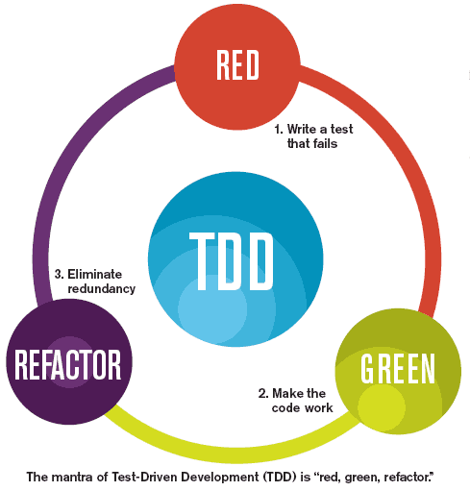
What is TDD?
Discipline of writing unit tests before writing a single line of code.
Goal: Clean code that works
Way of managing fear.
Phases
Red
Green
Refactor

Slide 14
TDD Benefits
Regression testing – not repeating same mistakes
Test First vs. Test Last
Full testability
Full coverage
Minimalistic implementation
Micro increments
Focus
Tests as To Do list

Slide 15
Example [4]- Email

Slide 16
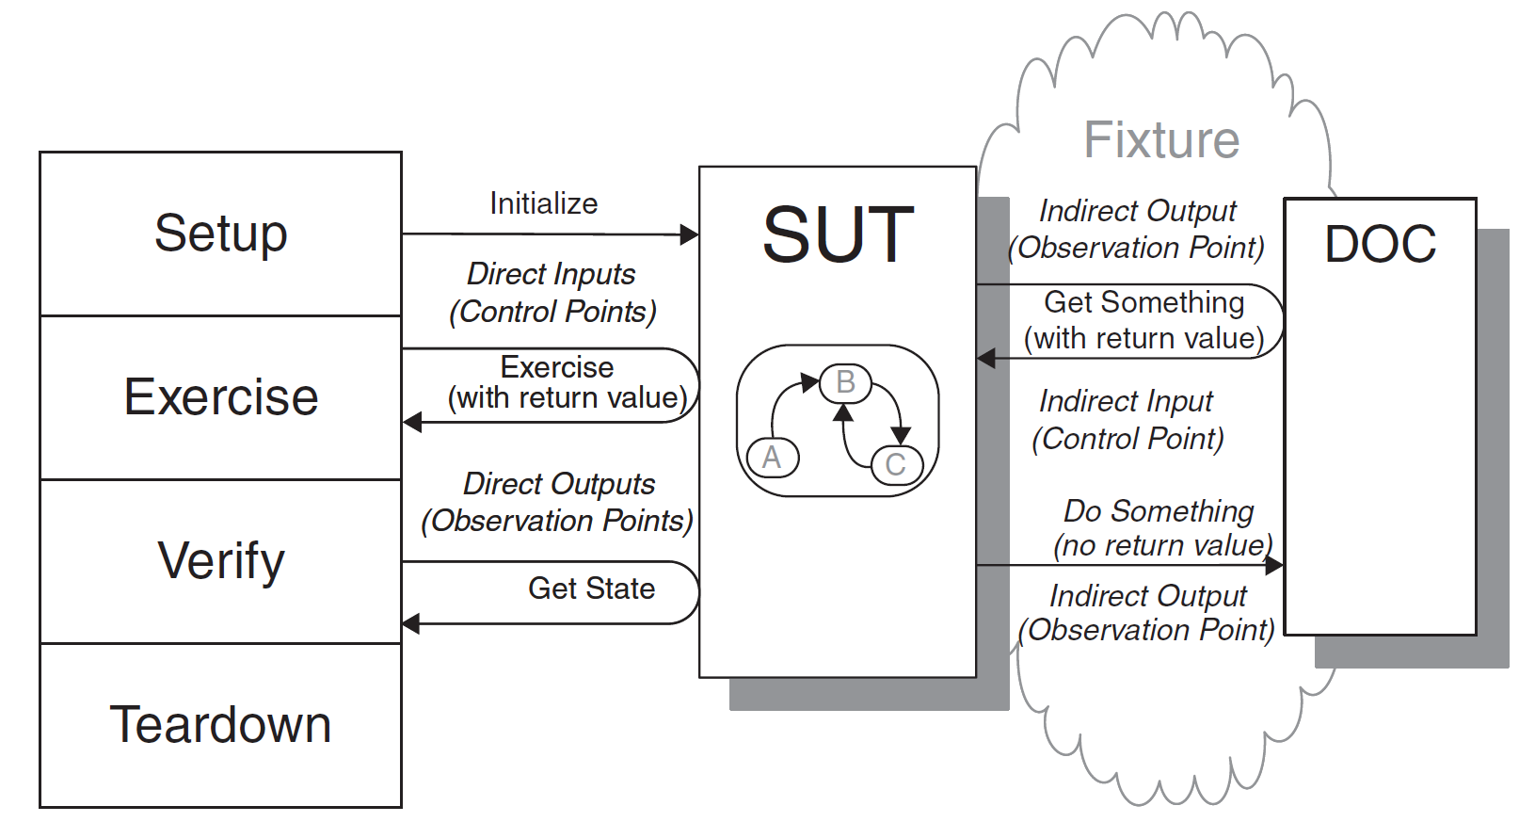
Fixture & DOC

Slide 17
Why Test Doubles?
Class isolation
Controlling SUT - indirect input
No visible output – indirect output
Setup simplification (DB)
DOC doesn’t exist
Communication testing
Speed
Easy teardown

Slide 18
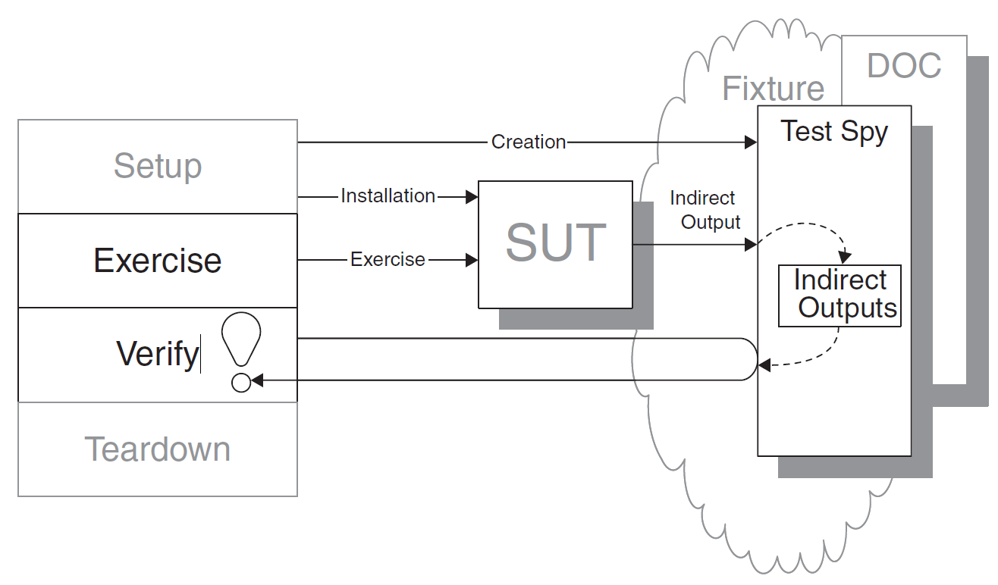
Test Spy

Slide 19
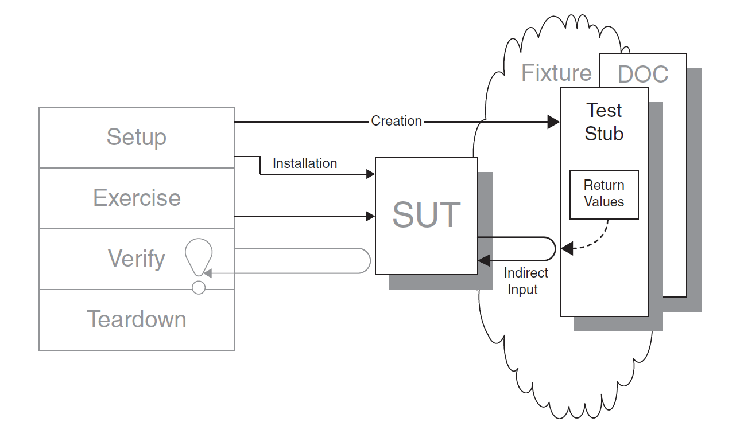
Test Stub

Slide 20
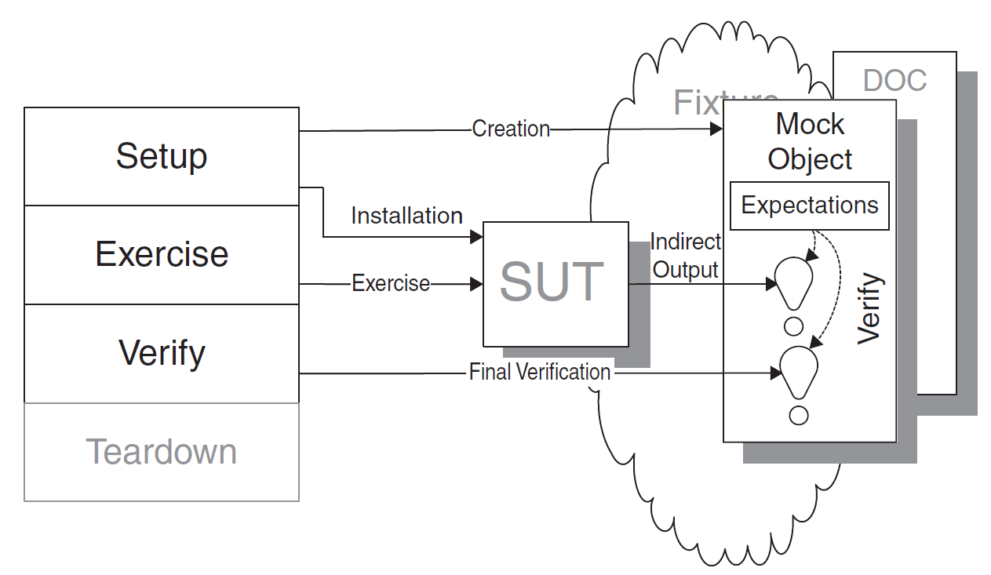
Mock Object

Slide 21
Creating the Test Double
Hand-Built
Configurable
Hard-Coded
Dynamically Generated
Forcing clean testable design
Don’t go wild

Slide 22
Installing the Test Double
Dependency Injection
Setter injection
Constructor Injection
Parameter Injection
Dependency Lookup
Factory
Factory Method
Test Specific SUT subclass
IoC Containers
Encapsulation?
User
Fake Mail Manager
Mail Manager

Slide 23
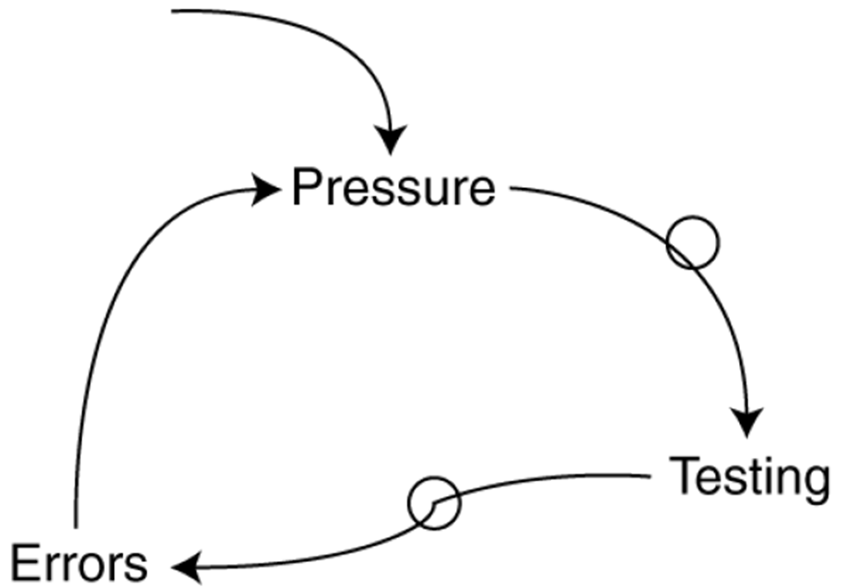
When?
When to start UT?
Start on project start.
When to write tests?
Always… when you can afford
When to stop?
When fear transform to boredom.
When to Run tests?
While coding
Before check-in
On automated build

Slide 24

Limitations
It’s a Change
More Code
Time
Only show the presence of errors, not proving absence of errors.
It will not catch integration errors
How can we verify that tests are working correctly?

Slide 25
Summary
Coding is hard
Unit Tests can help greatly
Start smart – small and evolve
Go TDD
Come to second presentation ☺

Slide 26
Questions?

Slide 27
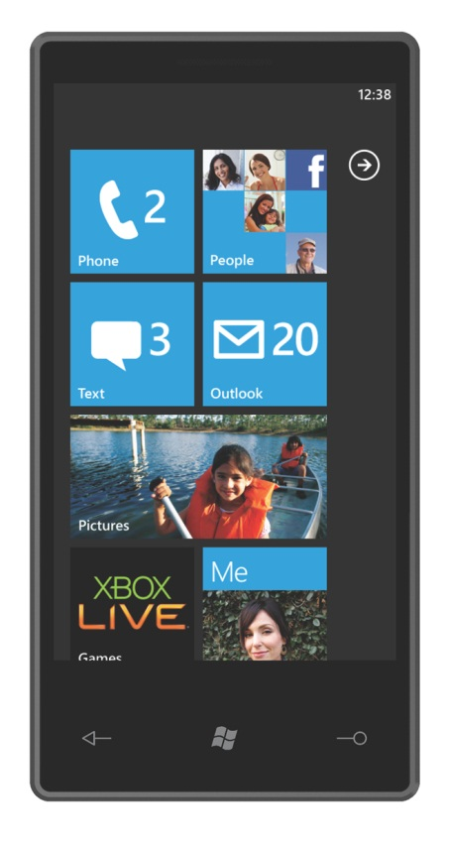
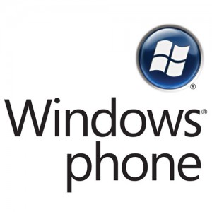

Please fill the questionnaire !
You have a chance to win:
Sponsored by:

Slide 28
Thanks!
Milan Vukoje
www.Vukoje.NET
vukoje@gmail.com

